Slide 1

SIMPLE LINEAR REGRESSION
Presented By,
Mr.R.Rajan,
Asst. Professor,
Dept. of AI&DS,
SMVEC.

Slide 2
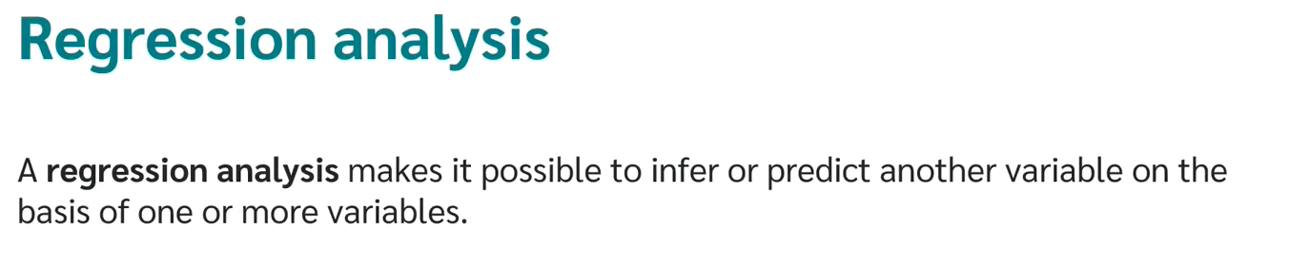
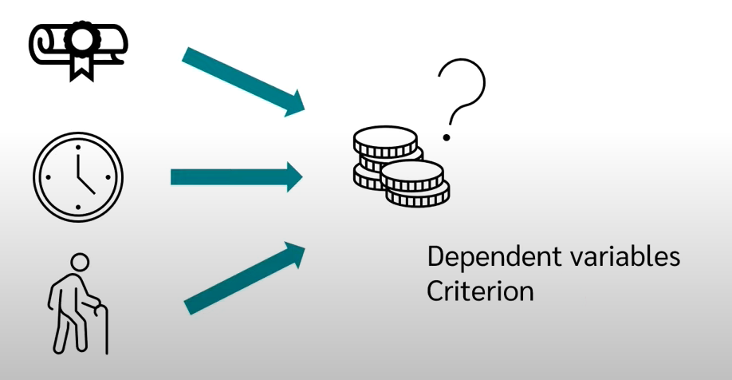

Slide 3

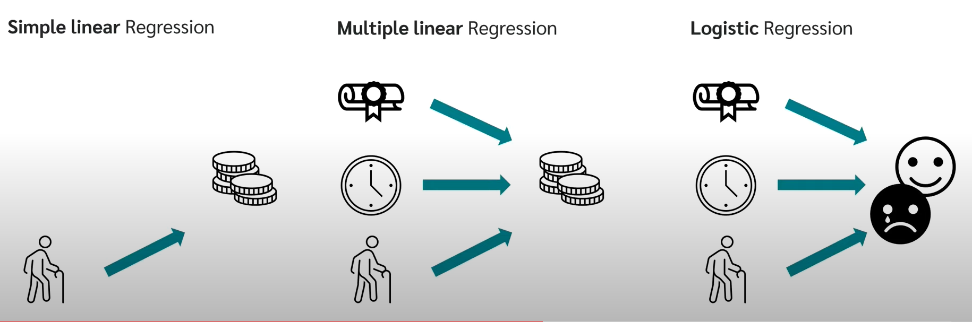

Slide 4
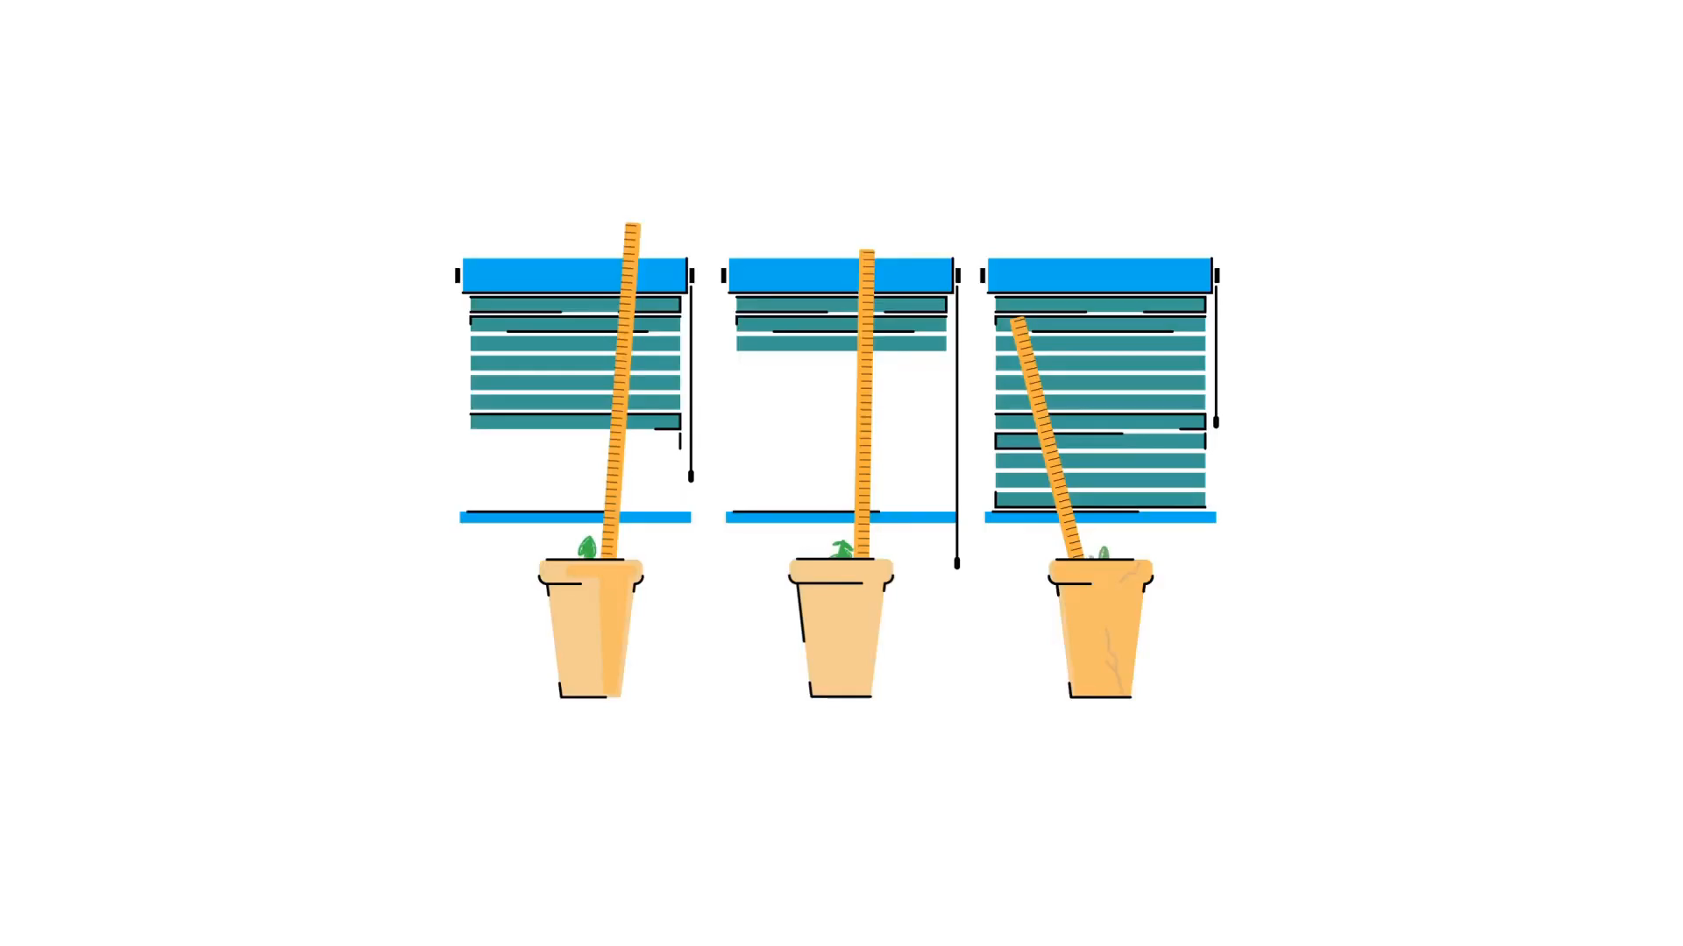

Slide 5
Bivariate and multivariate models
(Education) x y (Income)
(Education) x₁
(Sex) x₂
(Experience) x₃
(Age) x₄
Bivariate or simple regression model
Multivariate or multiple regression model
y (Income)

Slide 6
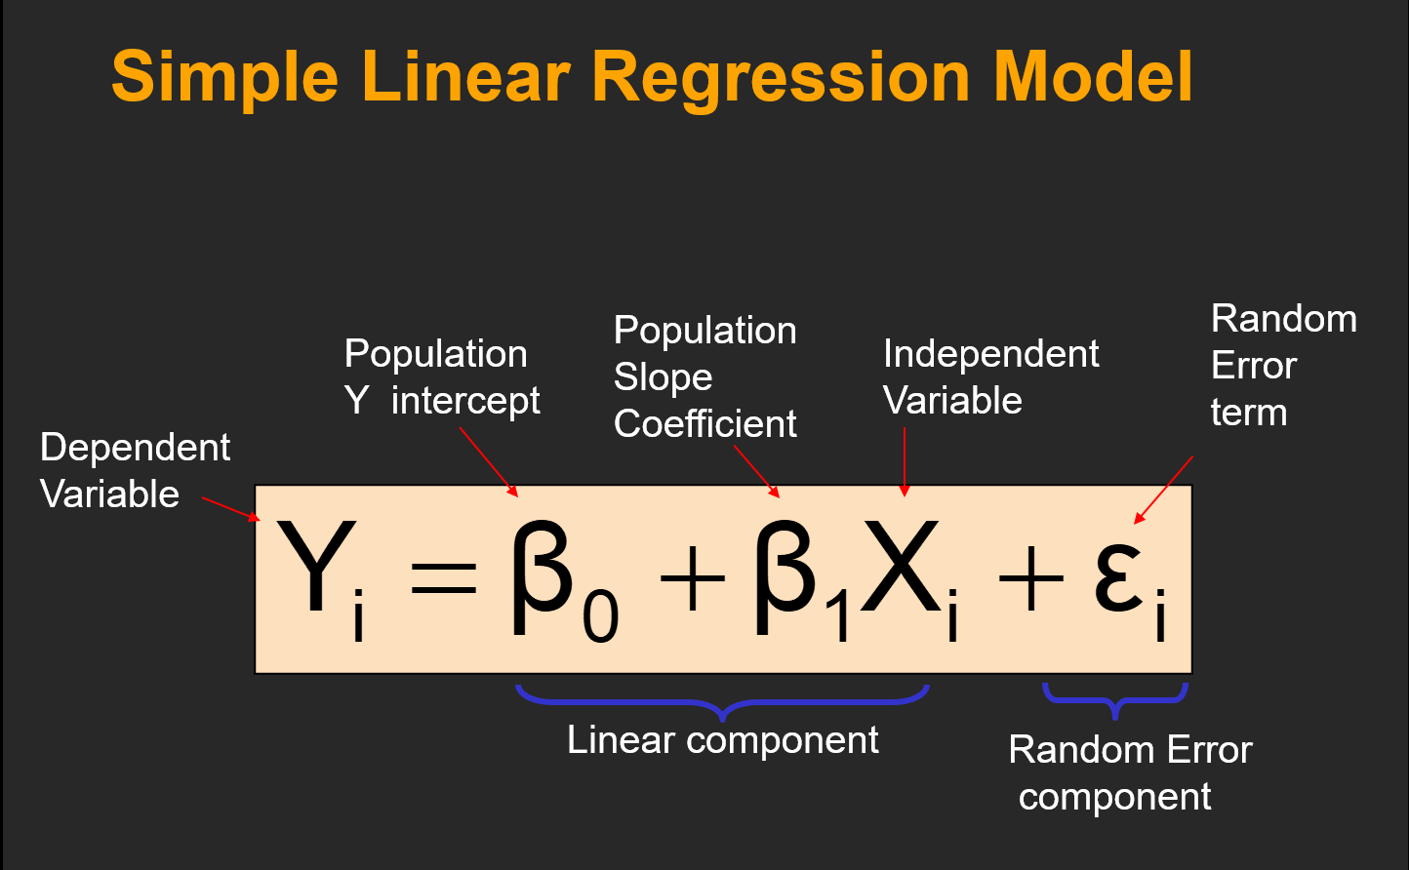

Slide 7

Simple Linear Regression Model

Slide 8
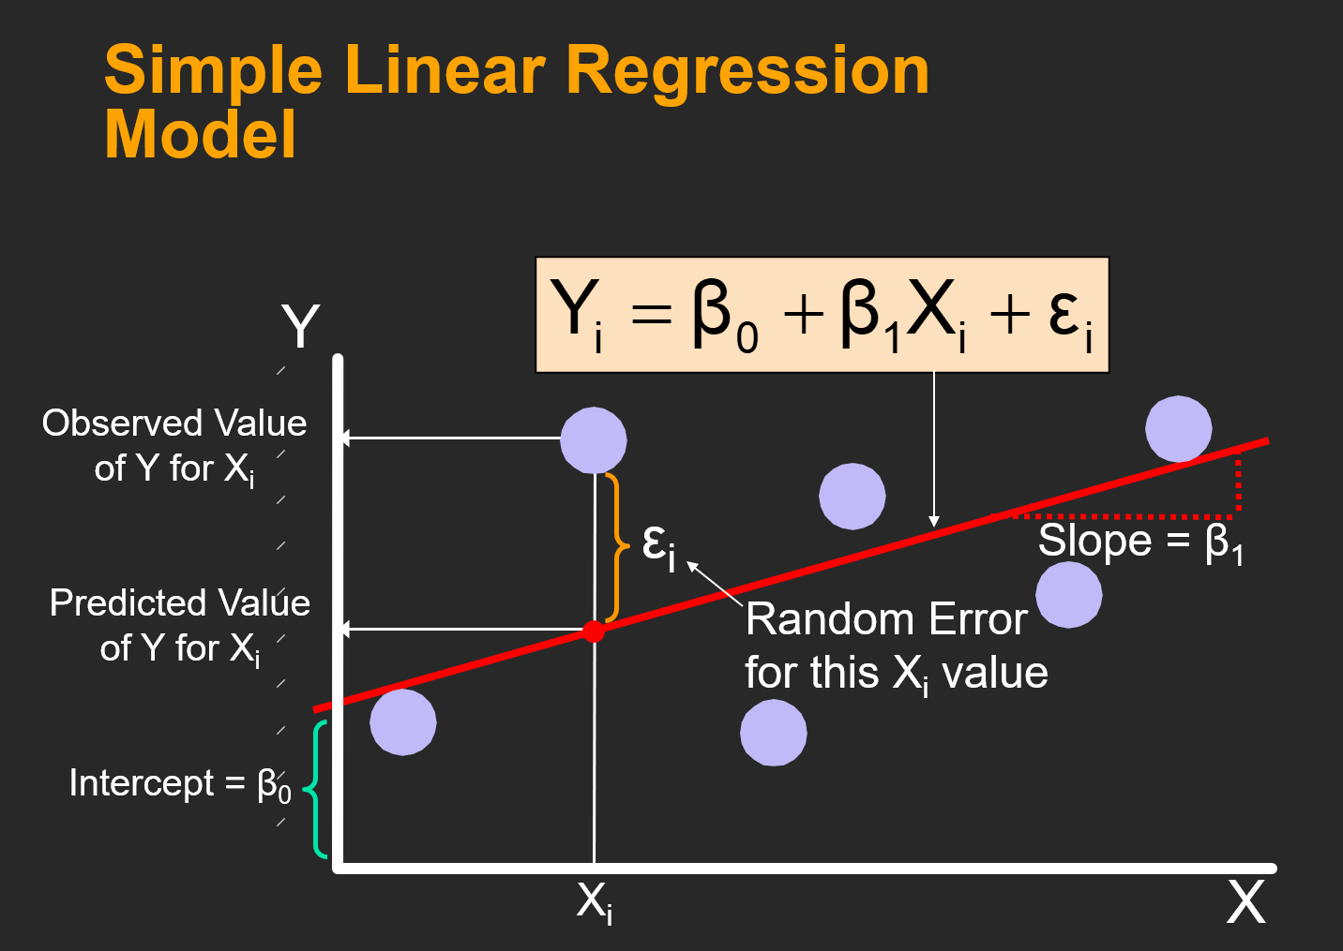

Slide 9
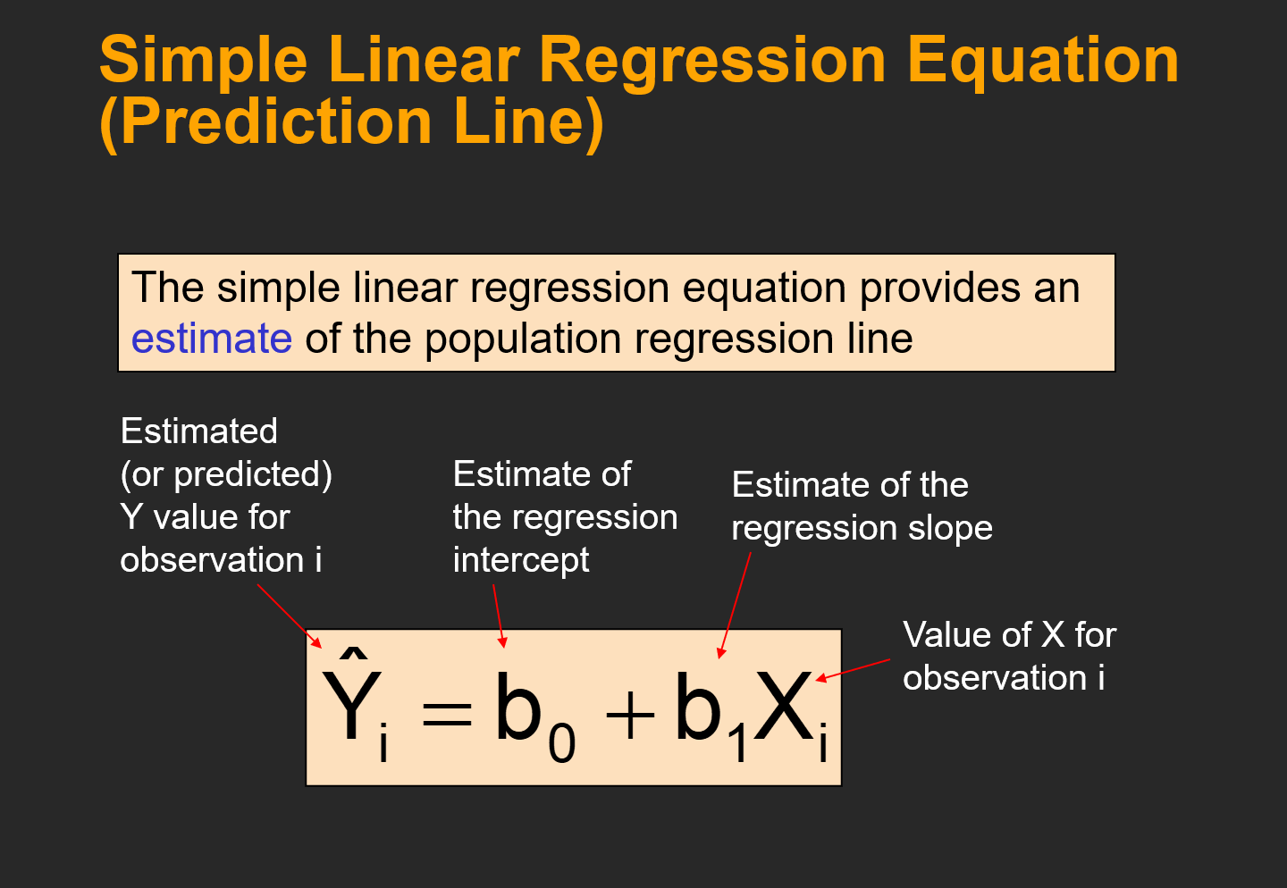

Slide 10
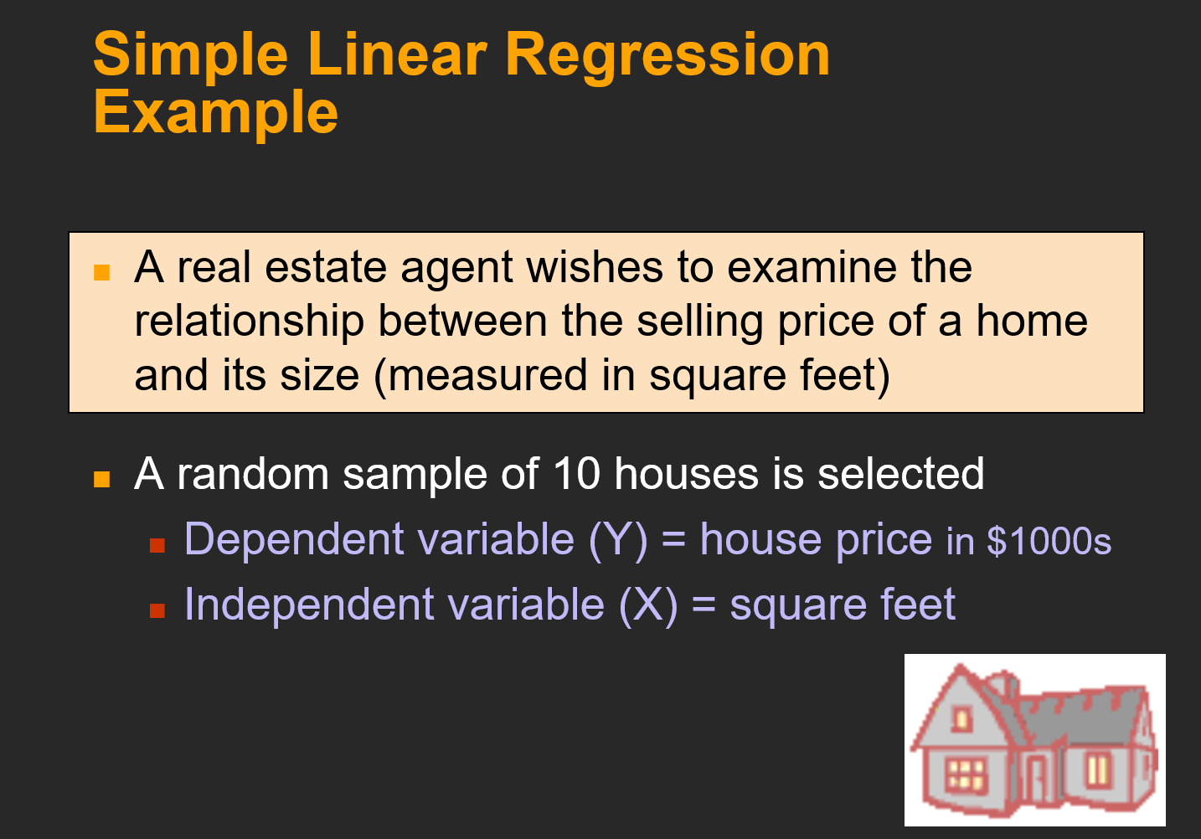

Slide 11
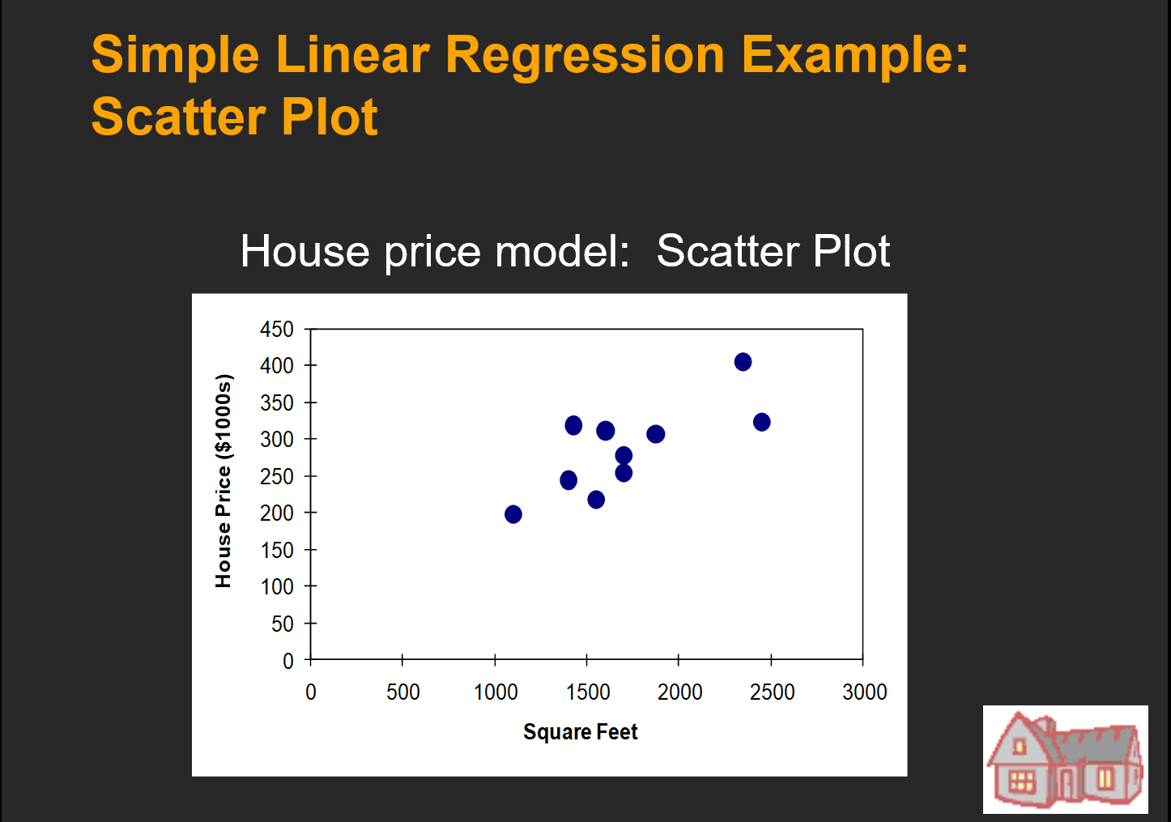

Slide 12
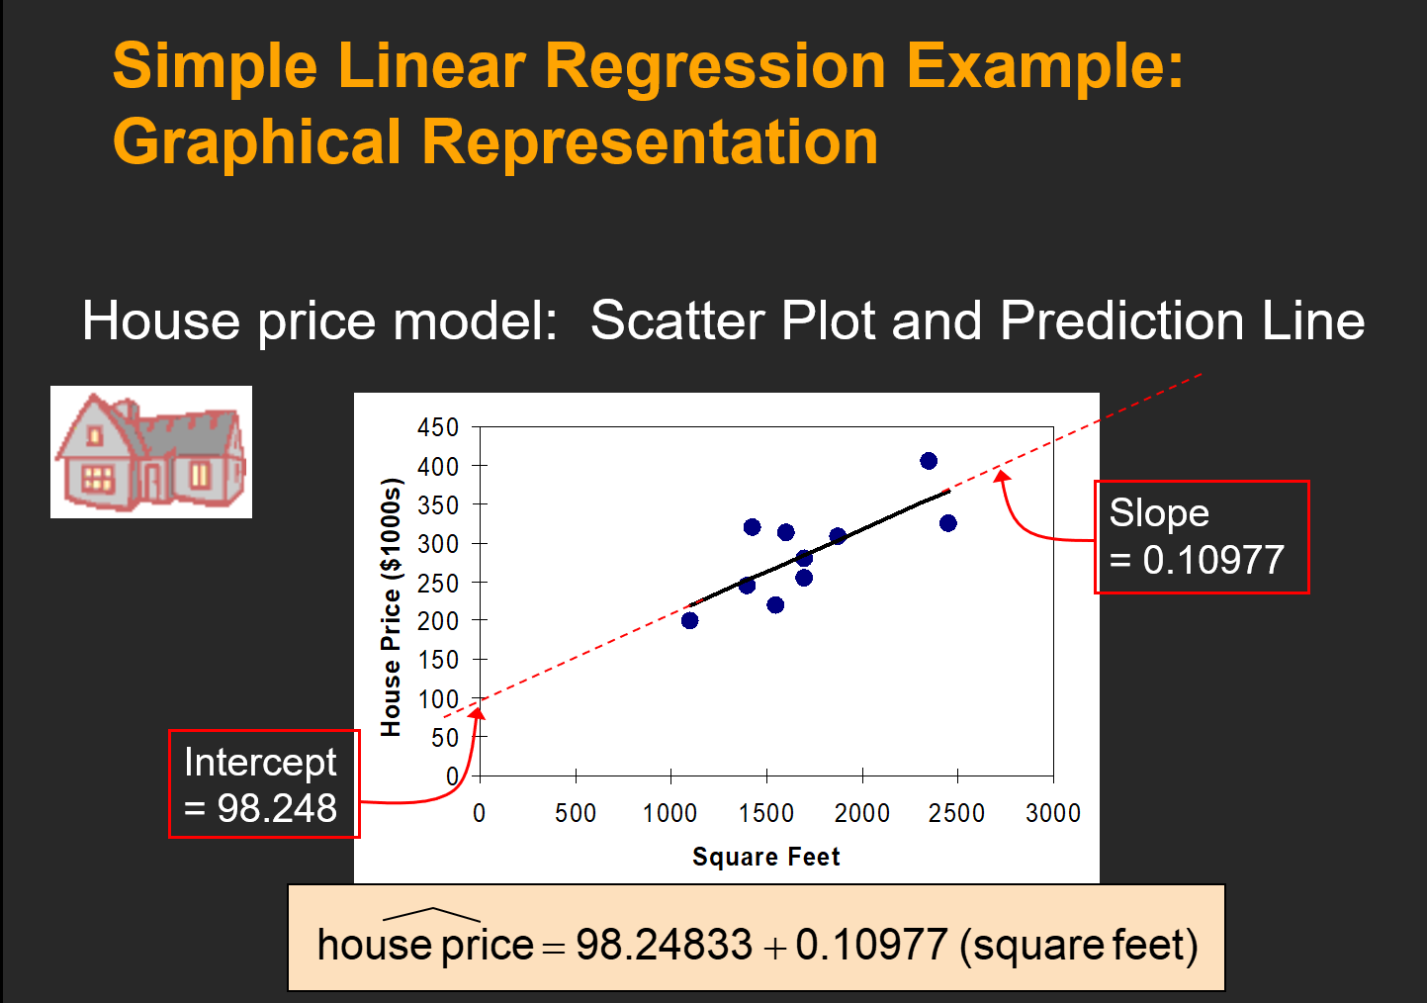

Slide 13
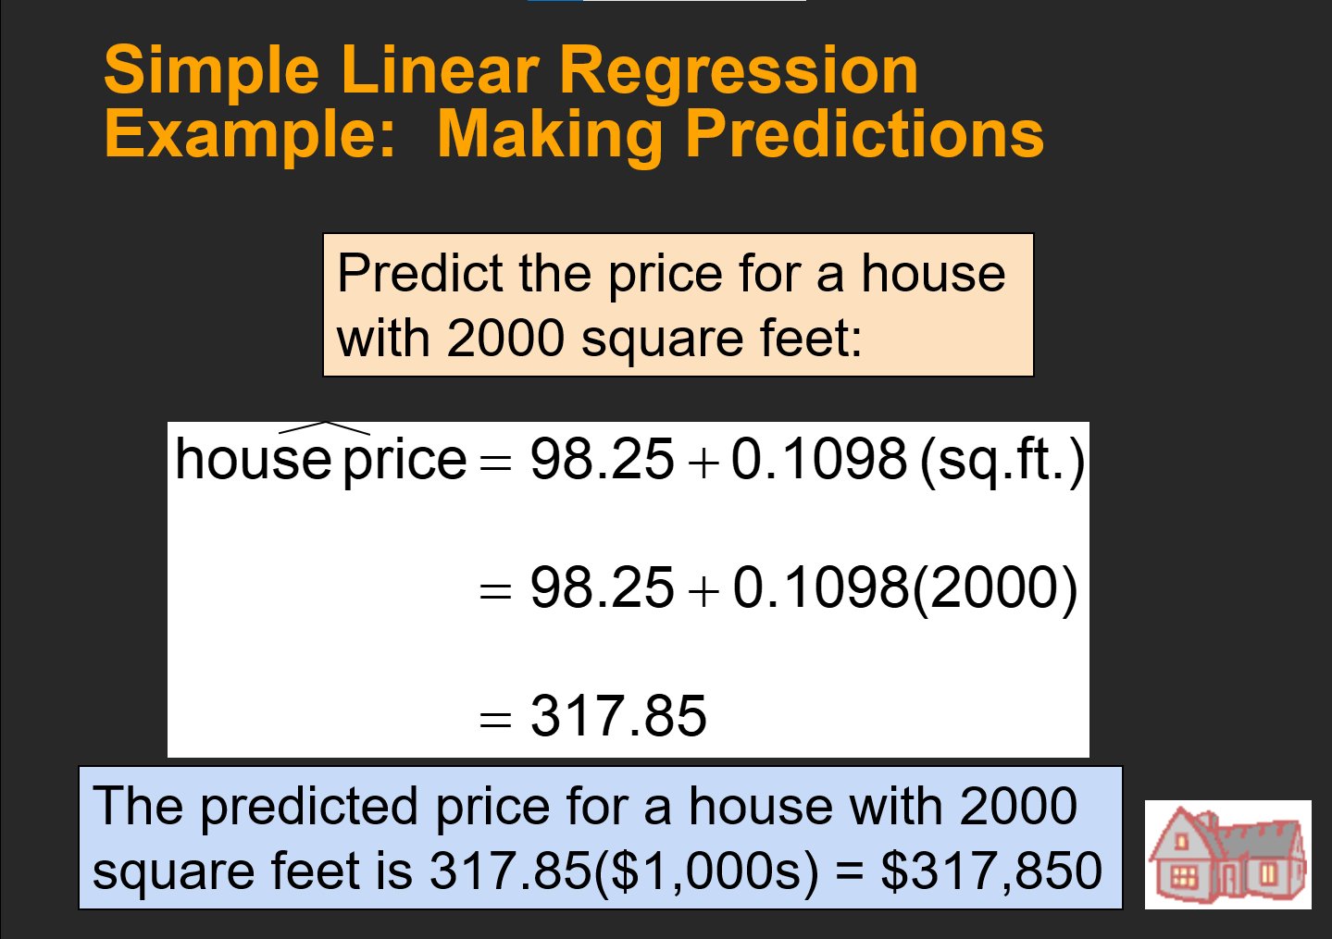

Slide 14

Linear regression can be applied in civil engineering
Construction Cost Estimation:
Project size, location, materials, labor costs, and other factors
Pavement Performance Prediction:
To predict the performance of pavement materials and structures
Traffic volume, environmental conditions, pavement age, and maintenance history
Structural Load Analysis:
Predicting structural loads on bridges, buildings, and other infrastructure.
Traffic loads, wind speeds, seismic activity, and environmental conditions

